Slide 1
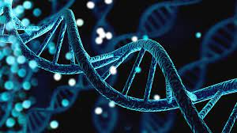
Scientific Data Management
Introduced by:
1- Mahmoud Medhat Mohamed
2-Mahmoud abdelghani
3-Galal Mostafa
4-Mohamed Fathi
5-Atta Ahmed
6-Alaa Ahmed
7-Mohamed Medhat Mohamed

Slide 2
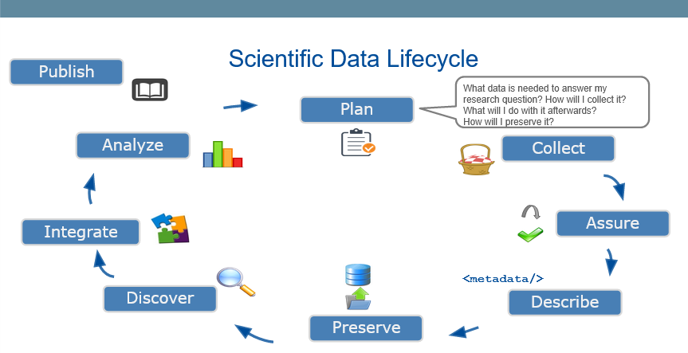

Slide 3
Plan phase
What I need in plan phase?
What data is needed to answer my research question?
How will I collect it?
What will I do with it afterwards?
How will I preserve it?

Slide 4
continue…
What data is needed to answer my research question?
differentially expressed genes (DEGs)
COL6A1 induction of bone metastasis in non-small cell lung cancer
How will I download Data?
Download it from existing research in NCBI
Then search about gene :GSE175601

Slide 5
Collect phase
How I collect the data?
Download it from existing research in NCBI.
Link of Data : https://www.ncbi.nlm.nih.gov/geo/query/acc.cgi?acc=GSE175601
How will I download Data?
Download it from existing research in NCBI
Then search about gene :GSE175601

Slide 6
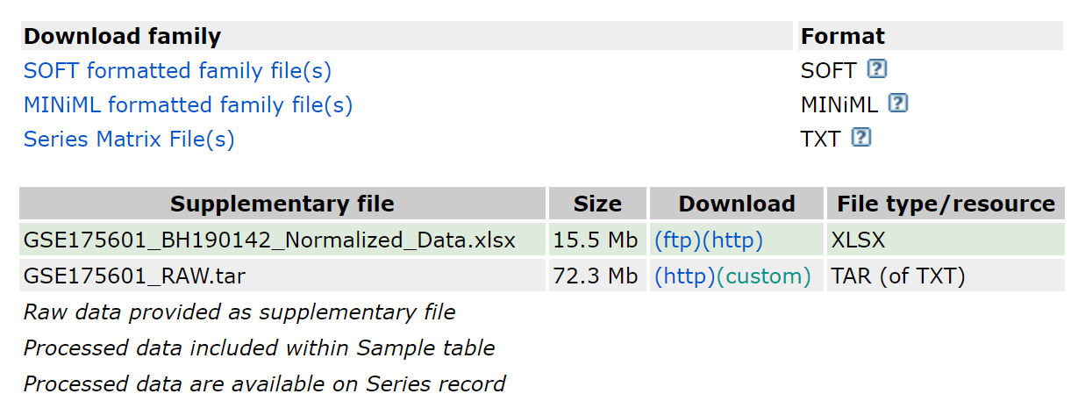
continue…
Which kind of organism I need ?
Homo sapiens
What type of experiment I need?
Expression profiling by array

Slide 7


Slide 8


Slide 9
Summary about Data
Non-small cell lung cancer (NSCLC) is a major cause of cancer-associated mortality worldwide, and bone metastasis is the most prevalent event observed in patients with advanced NSCLC.
In the present study, differentially expressed genes (DEGs) were identified by gene expression microarray analysis of NSCLC tissue samples with or without bone metastases.

Slide 10
Some Terms
Bone metastasis: occurs when cancer cells spread from their original site to a bone.
A gene is declared differentially expressed: if an observed difference or change in read counts or expression levels between two experimental conditions is statistically significant.
(COL6A1) :Collagen family collagen 6A1 was chosen as the target gene
The up-regulated genes are mainly components that control cellular proliferation, whereas the down-regulated genes consist of proteins exposed on or secreted from the cell surface.

Slide 11
The final result extracted from the data
Functionally, COL6A1 overexpression induced the proliferation and invasion of HARA cells, and prevented the proliferation and invasion of HARA-B4 cells.
Finally, it was demonstrated that HOB and hES-MP 002.5 cells exhibited osteogenic capacity, and overexpression of COL6A1 in HARA cells increased adhesion of these cells to the osteoblasts (HOB and hES-MP 002.5), whereas knockdown of COL6A1 in HARA-B4 cells reduced their adhesive ability.
In conclusion, COL6A1 may serve as a potential diagnostic marker and therapeutic target for bone metastasis in NSCLC.

Slide 12
Assurance
How can I check for data quality?
How can I describe data quality?
How can I improve data quality?
By Open Refine I con do all that

Slide 13


Slide 14
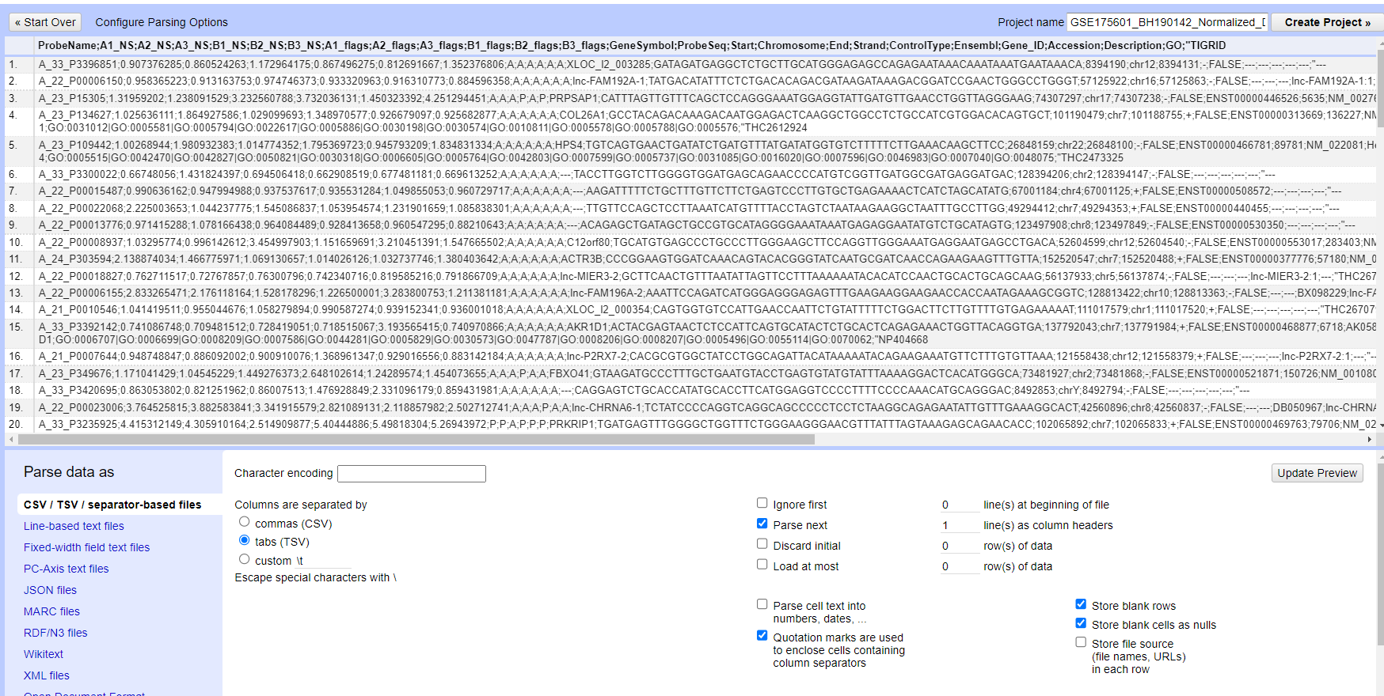
Upload data on open refine
Open refine and create project then select data then press next button

Slide 15

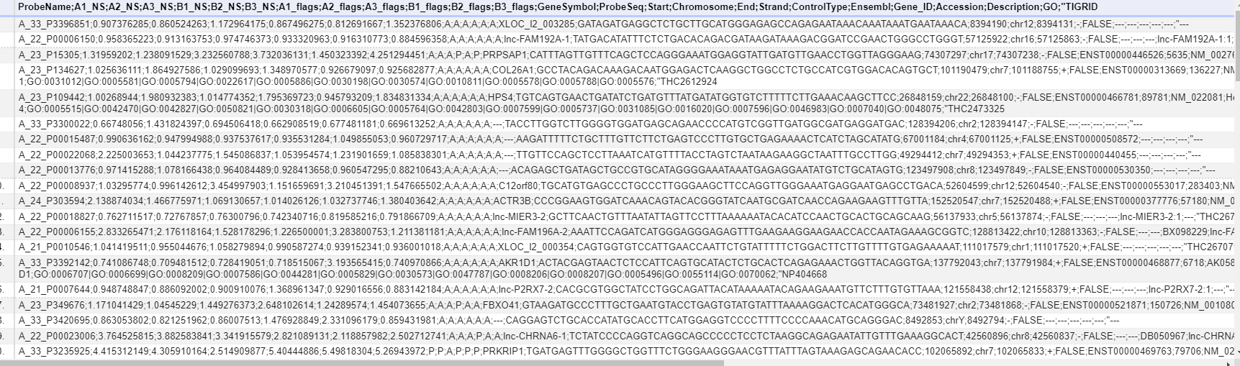
Data before cleaning

Slide 16
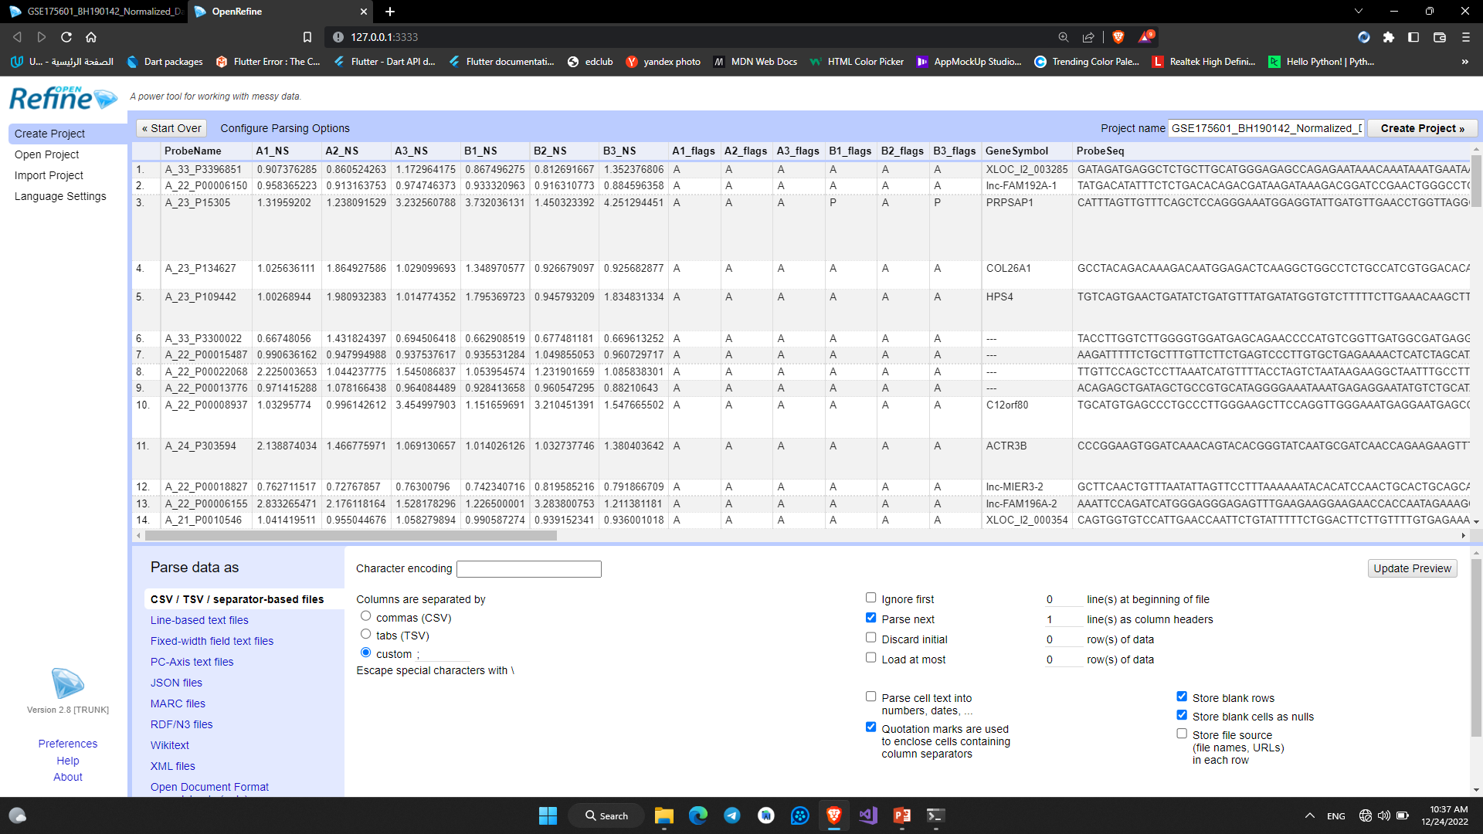
Using custom(;) to separate columns

Slide 17
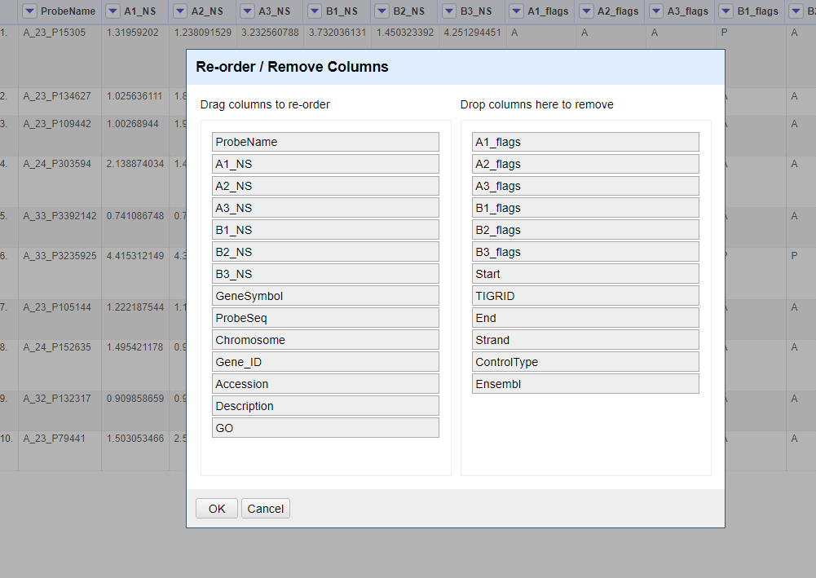
Removing columns without using

Slide 18
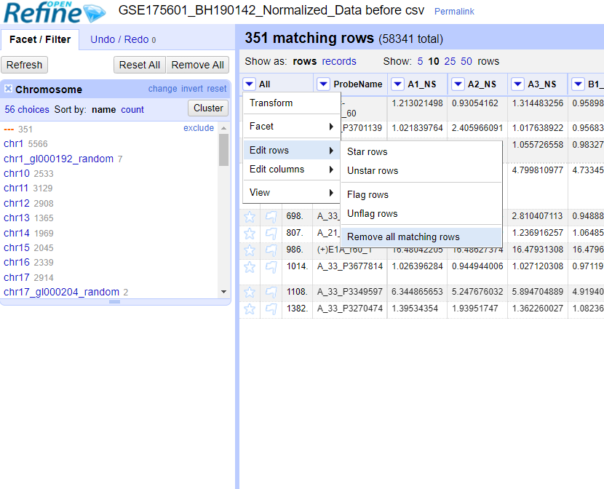
Remove “---”rows in Chromosome field and other columns

Slide 19
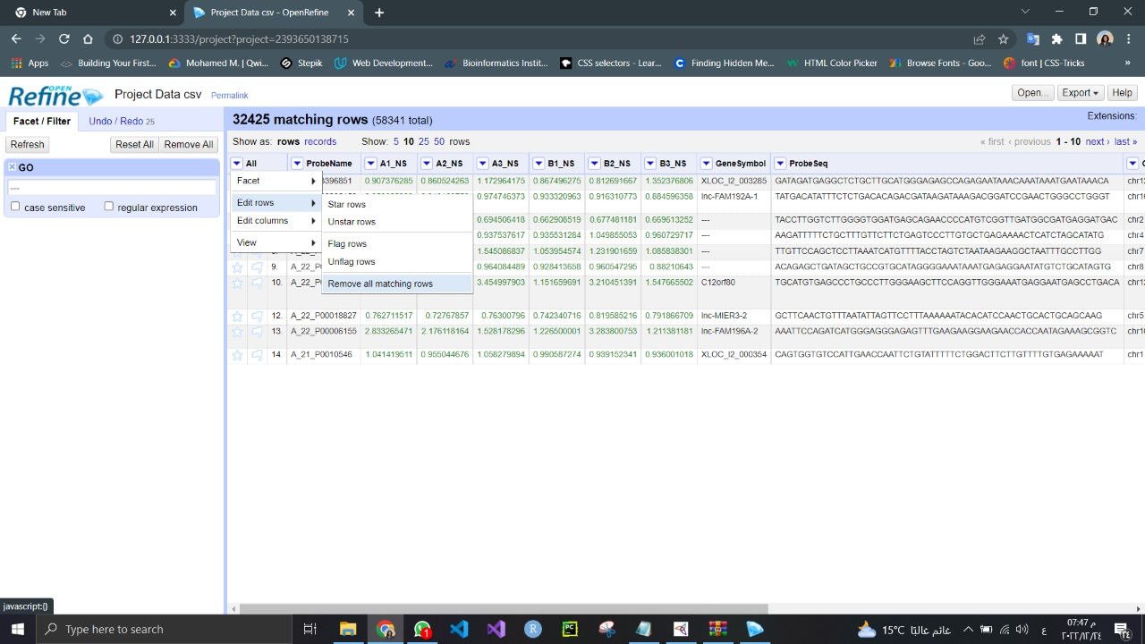
Remove “---”rows in GO field and other columns

Slide 20
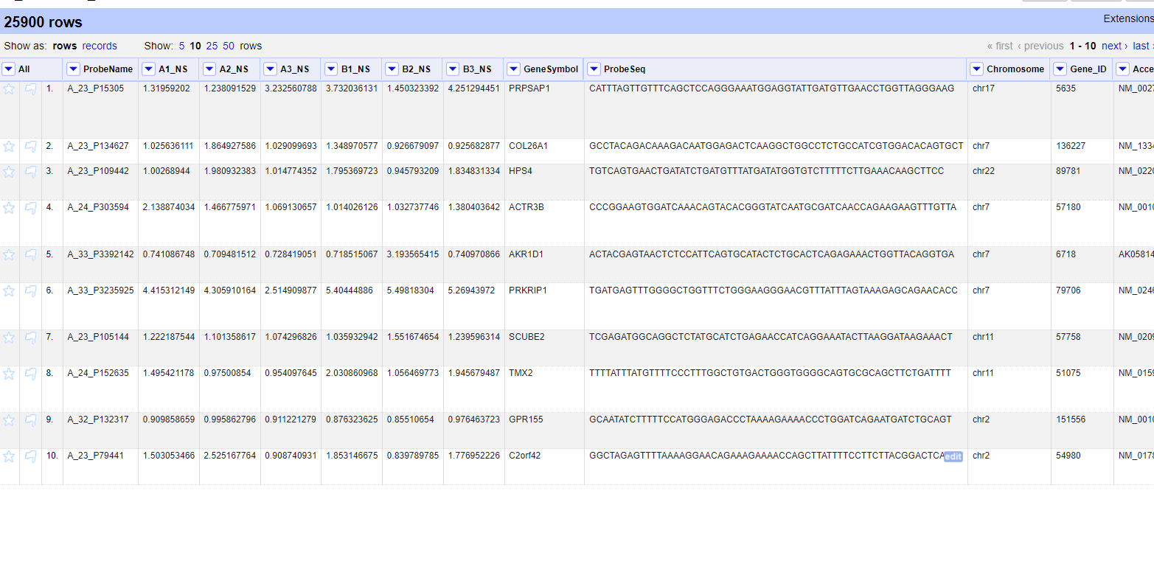

Dataset after cleaning

Slide 21
Data table header descriptions
ID | Agilent Probe Name
REFSEQ | RefSeqAccession
GB_ACC | GenBankAccession
GENE_SYMBOL | Gene Symbol
ACCESSION_STRING | Accession String
CHROMOSOMAL_LOCATION | Chromosomal Location
DESCRIPTION | Description
GO_ID | GO
SEQUENCE | Sequence

Slide 22

visualization

Slide 23
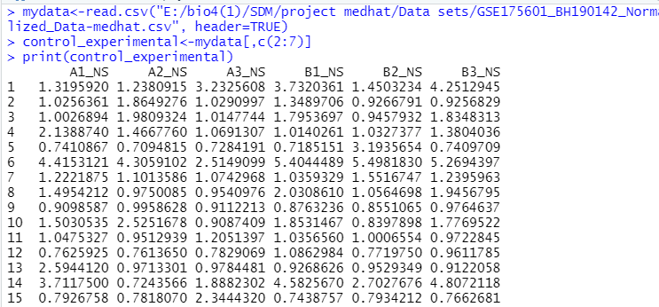
I Describe Data Quality by R
When I read data and print experiments

Slide 24
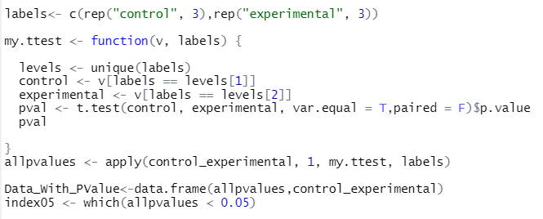
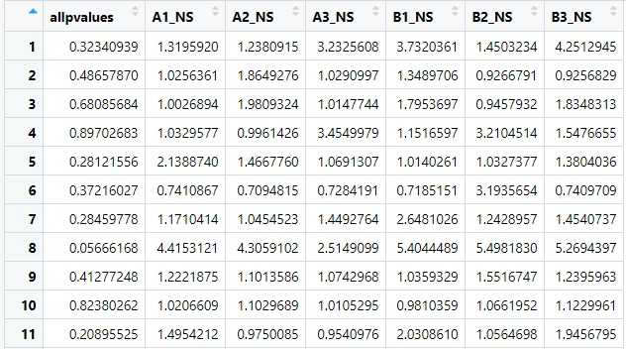
Add t-test and filtered p-value reduce 0.05

Slide 25
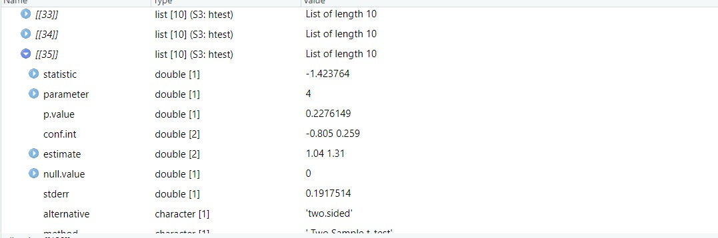
T-test

Slide 26
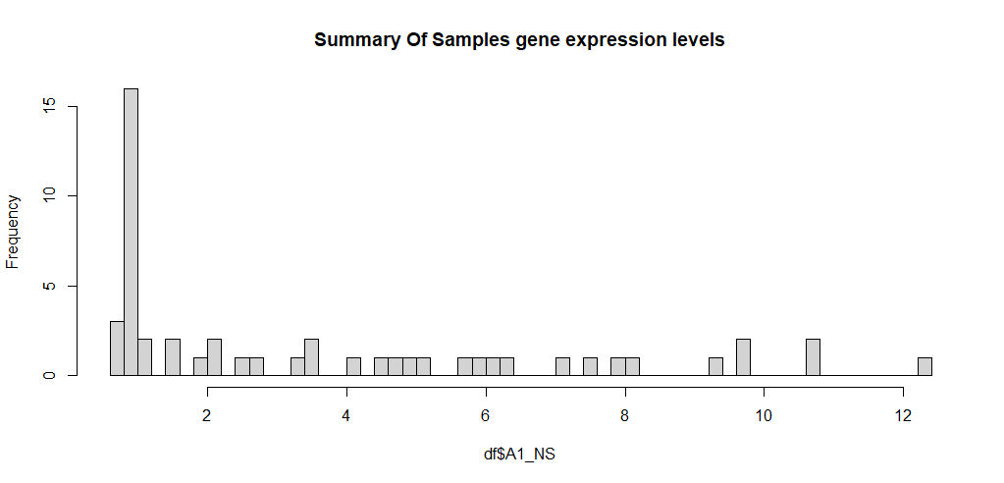
Histogram for samples
- Histogram is very easy to be understood especially with biological data.
Useful to compare values with different shapes.

Slide 27
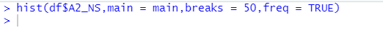
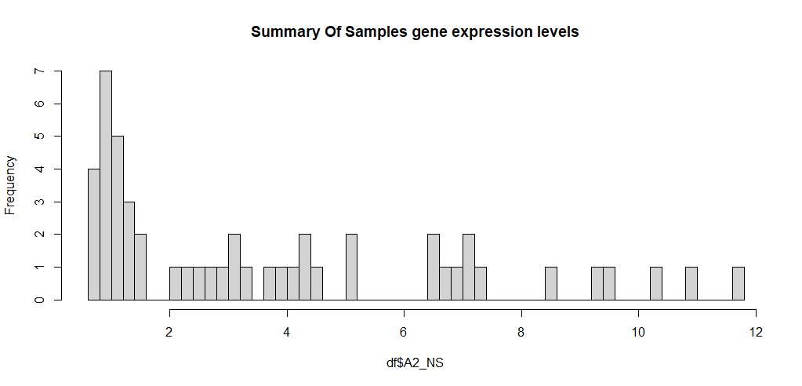
Histogram for samples

Slide 28
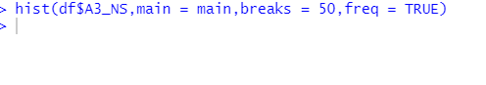
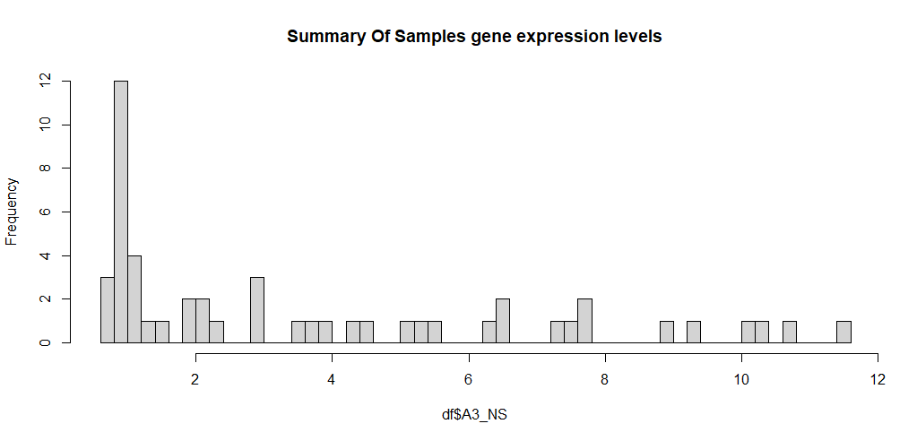
Histogram for samples

Slide 29
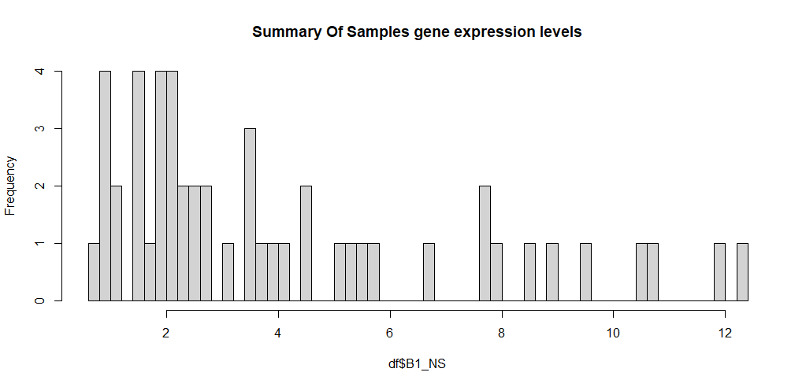
Histogram for samples

Slide 30
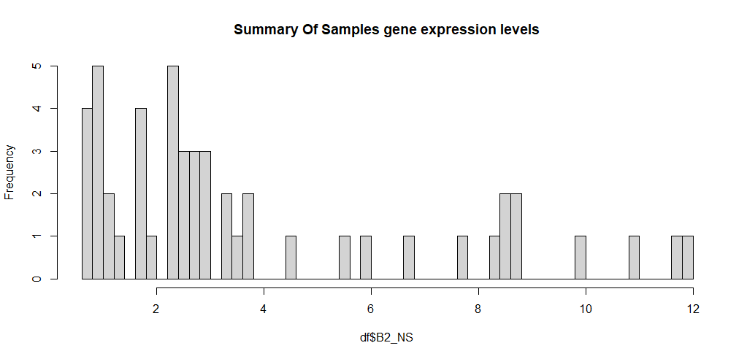
Histogram for samples

Slide 31
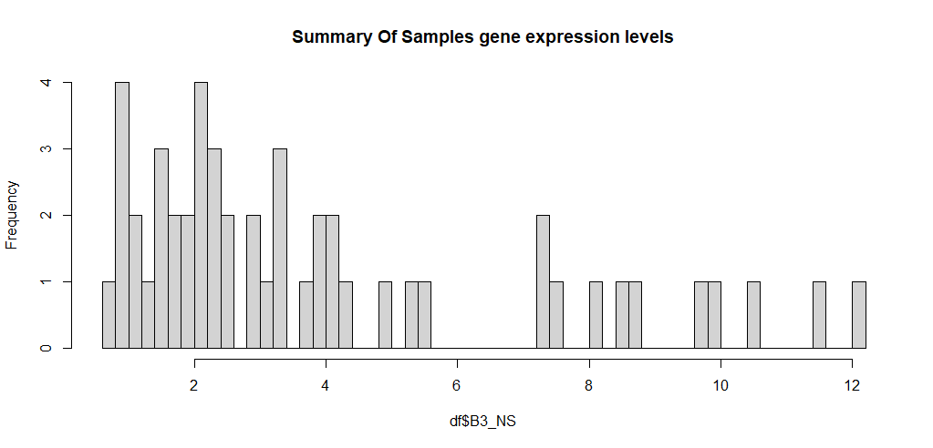
Histogram for samples

Slide 32
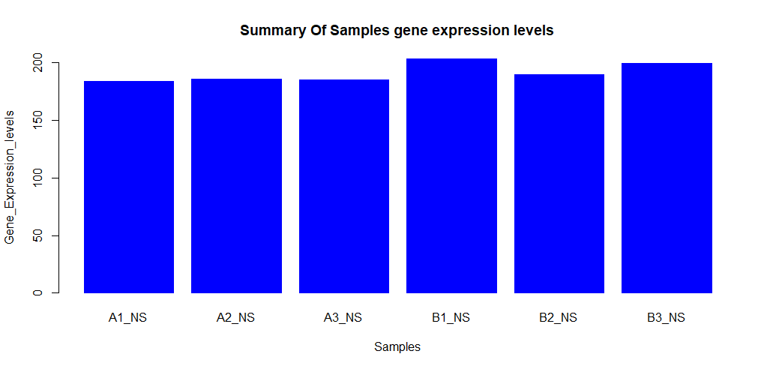
Barplot for 6 samples
the help of bar diagrams, it is easy to compare data sets from different groups. The main objective is to demonstrate the relationship between the two axes.

Slide 33
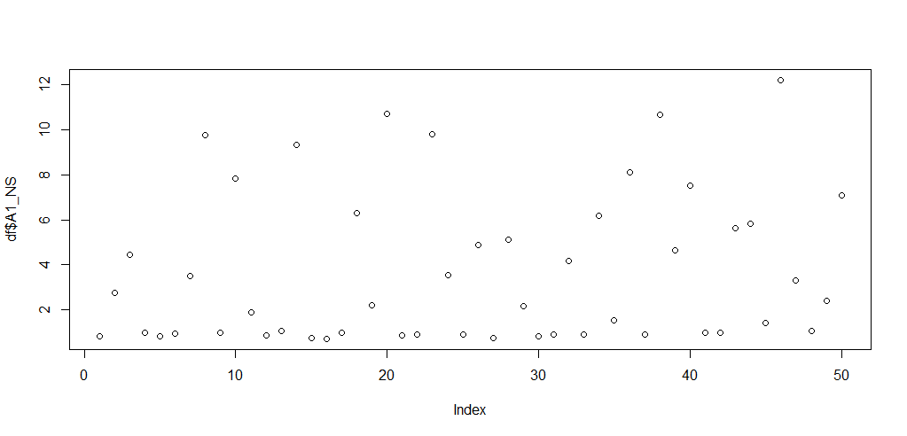
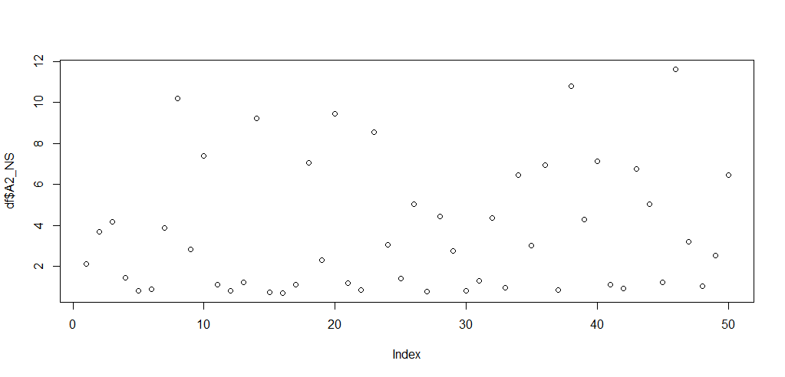
plot for 3 samples
it gives us a visual of the data that we can use to better see how the data is behaving and make observations and predictions based on that behavior.
A1
A2

Slide 34
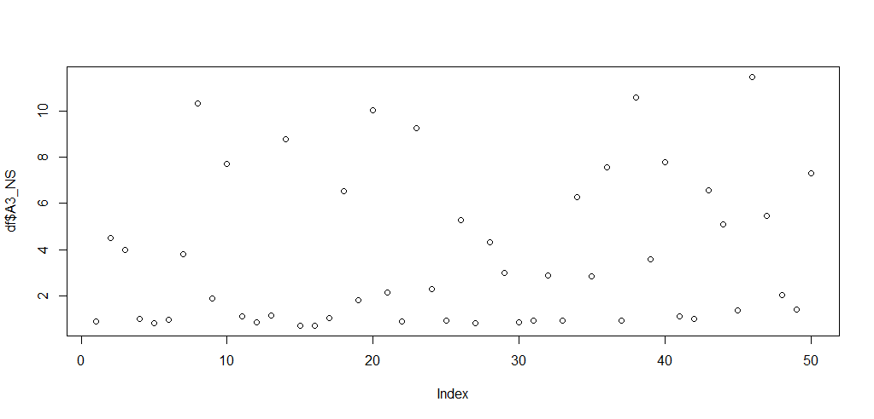
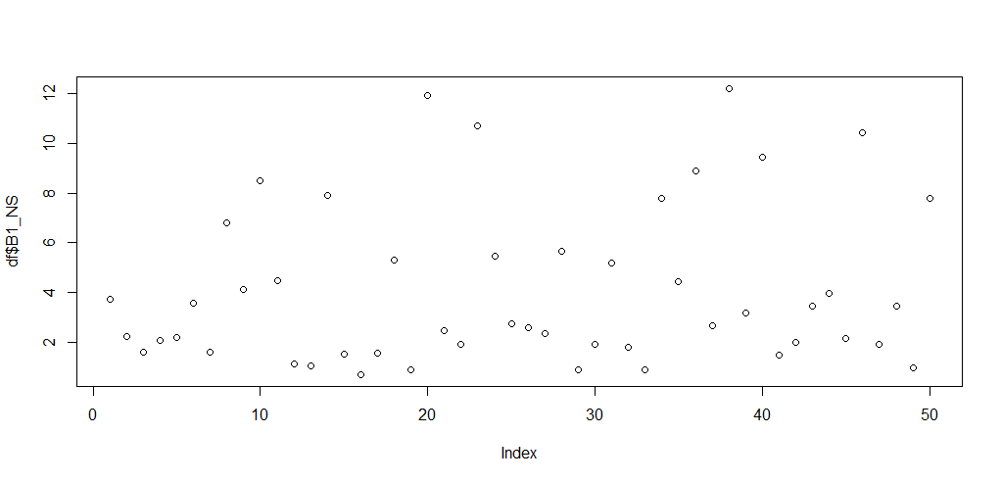
plot for 3 samples
A3
B1

Slide 35
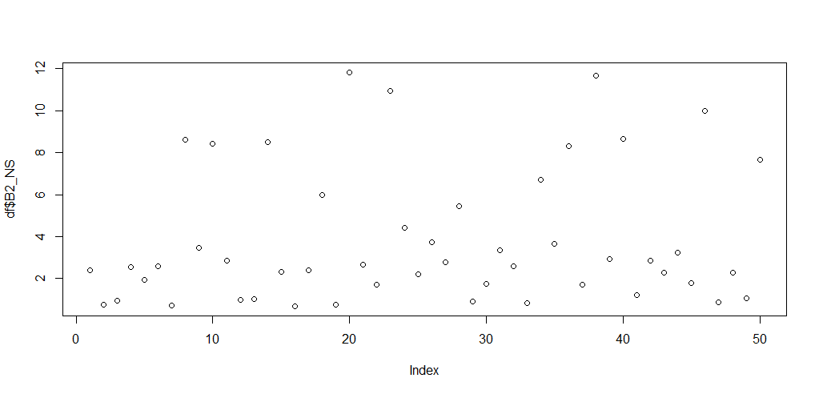
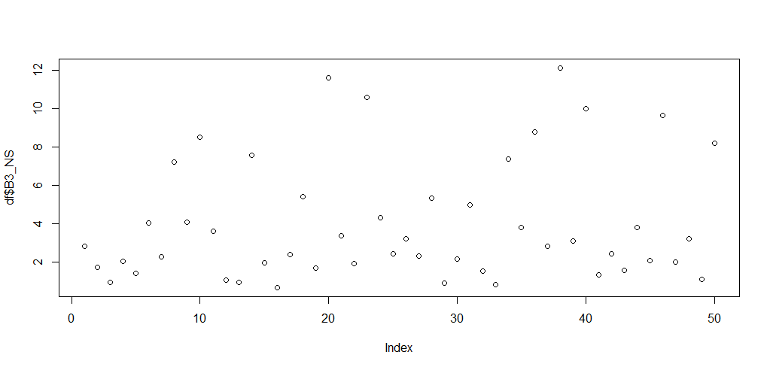
plot for 3 samples
B2
B3

Slide 36
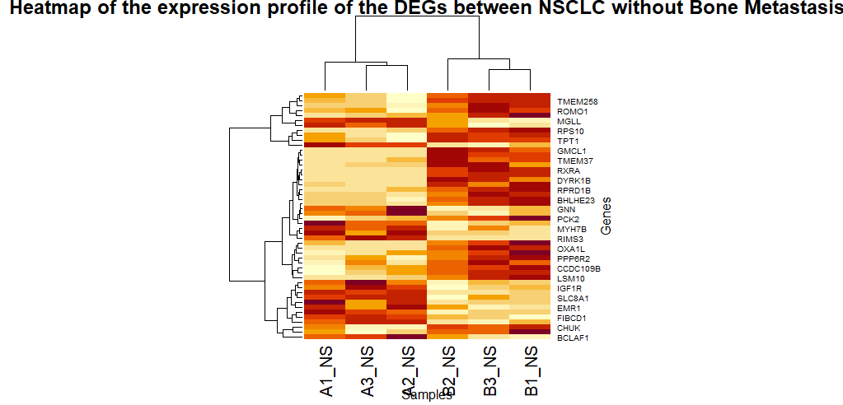
Heat map
We use Heatmap because heatmap is very useful in visualizing the concentration of values between two dimensions of a matrix. This helps in finding up and down regulated genes.

Slide 37
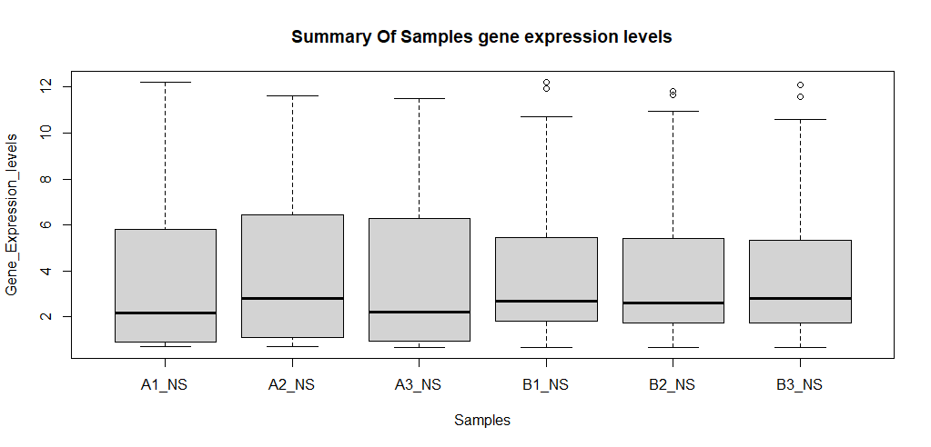
boxplot
We use boxplot because Box plots are useful as they provide a visual summary of the data enabling us to quickly identify mean values, the dispersion of the data set, and signs of skewness.

Slide 38
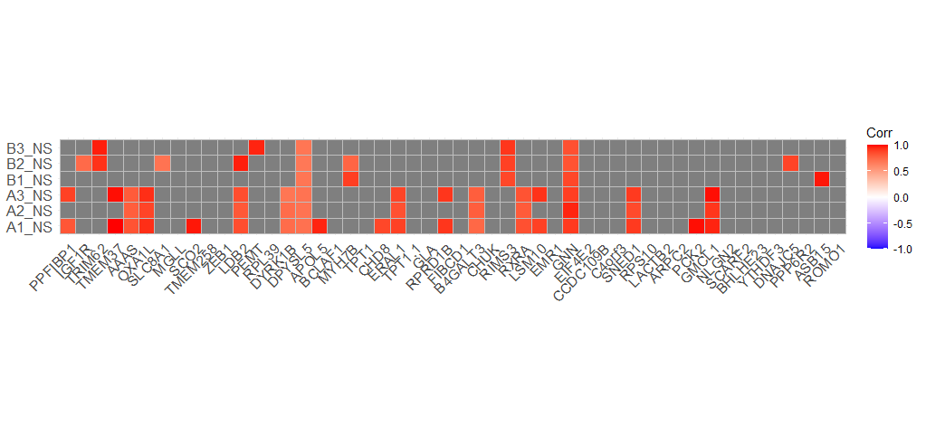
Correlation plots

Slide 39
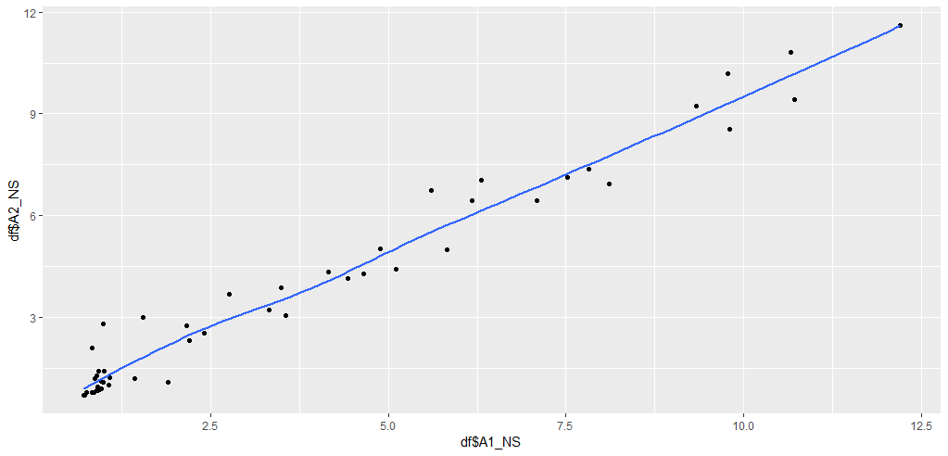
Geom point plot
A1&A2&A3

Slide 40
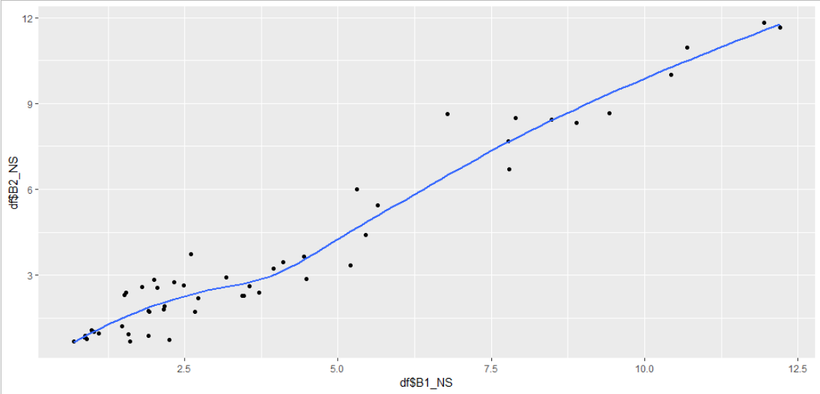
Geom point plot
B1&B2&B3

Slide 41

Ontology

Slide 42
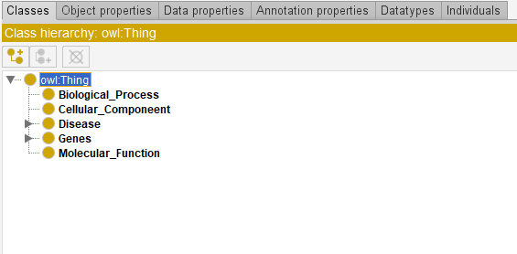
Classes of ontology

Slide 43
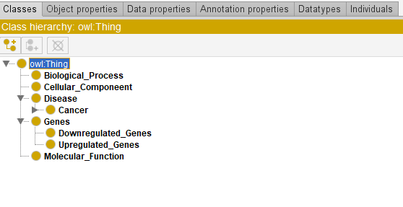
SubClasses of ontology

Slide 44
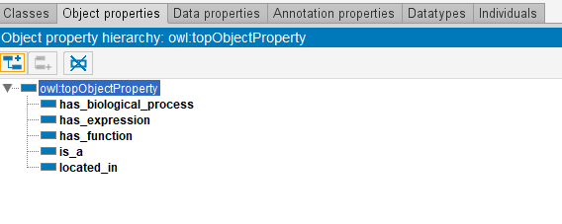
object properties

Slide 45
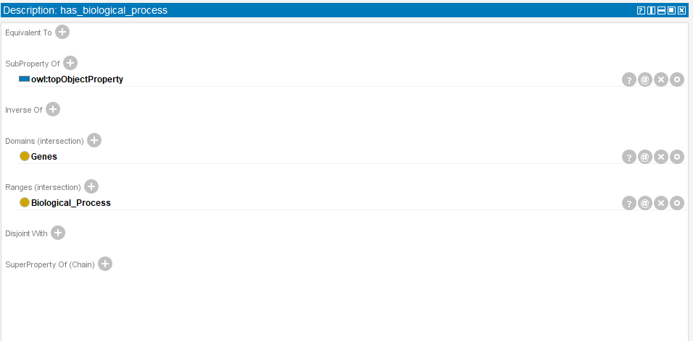
has biological process (object property)

Slide 46
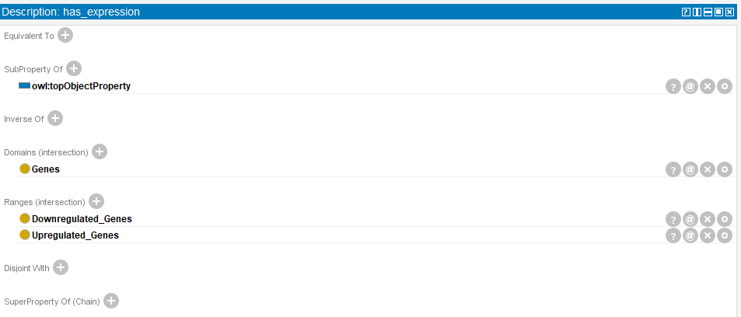
has expression (object property)

Slide 47
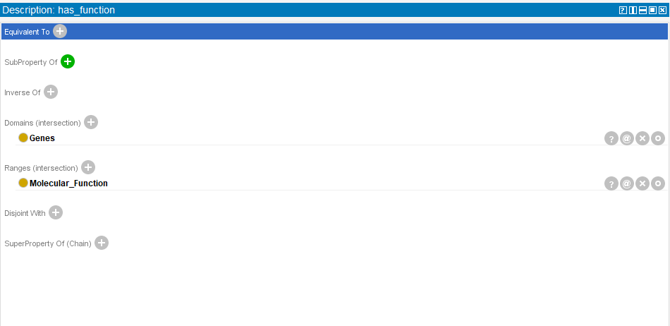
has function (object property)

Slide 48
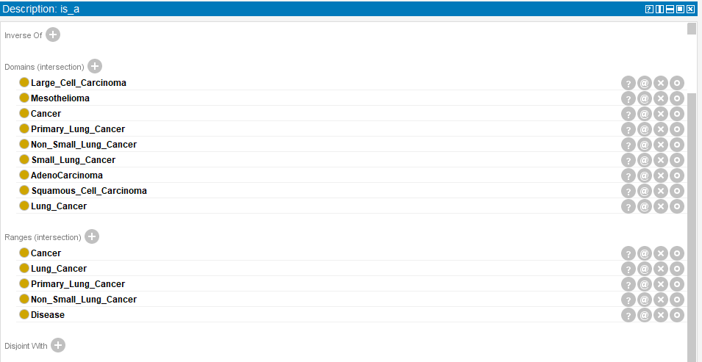
is_a (object property)

Slide 49
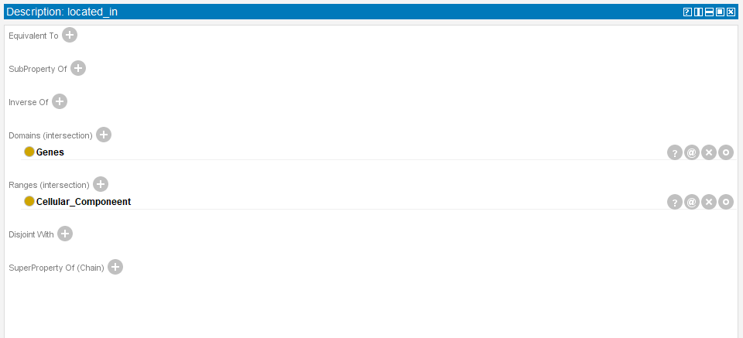
Locateed_in (object property)

Slide 50
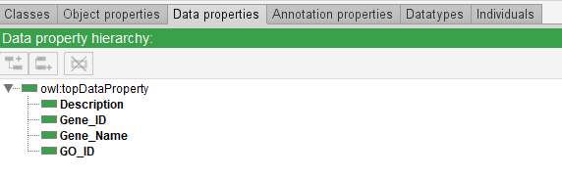
data propertiees

Slide 51
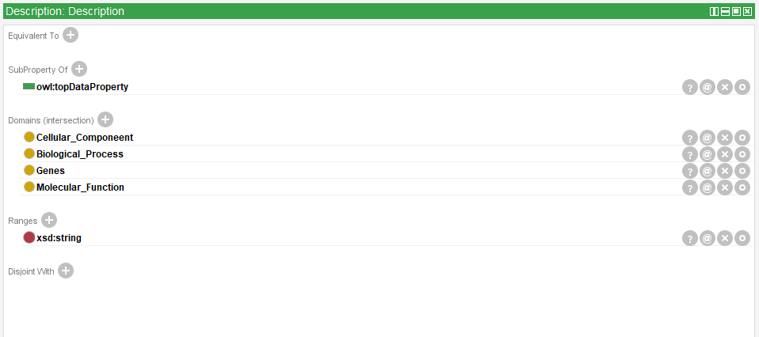
description (data property)

Slide 52
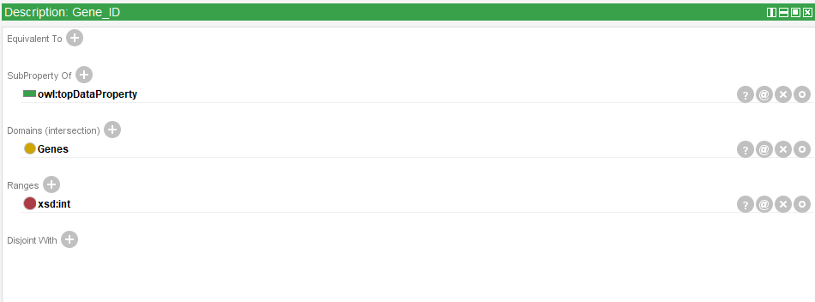
gene_id (data property)

Slide 53
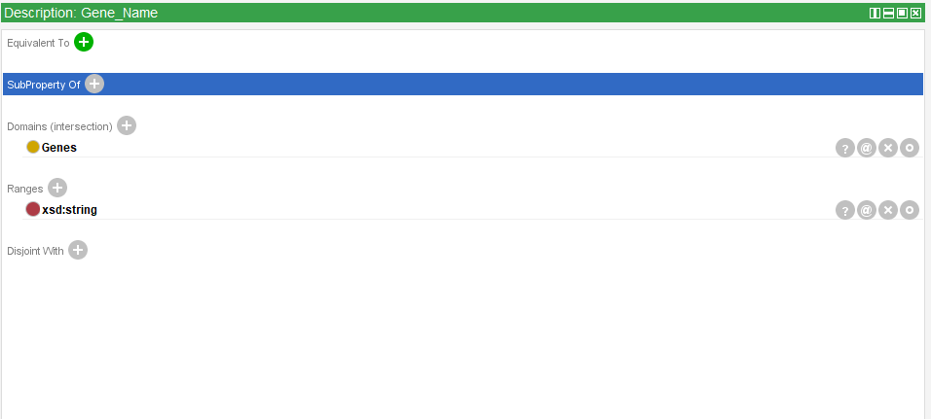
gene_name (data property)

Slide 54
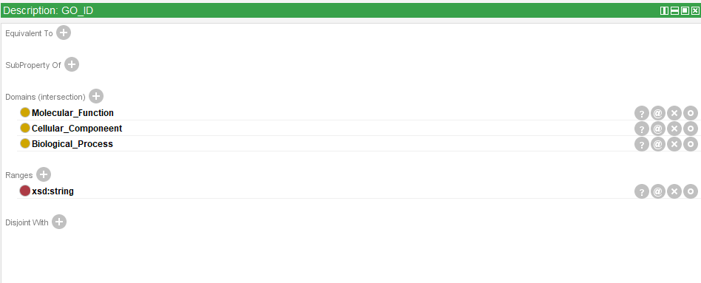
GO_id (data property)

Slide 55
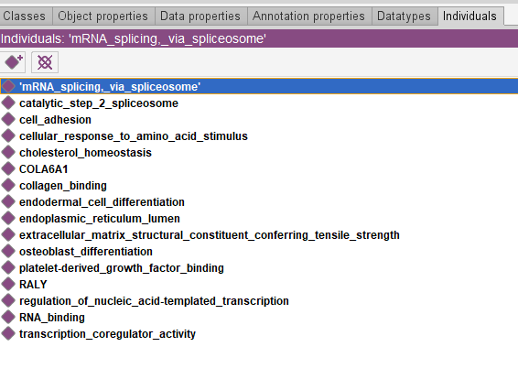
individuals

Slide 56
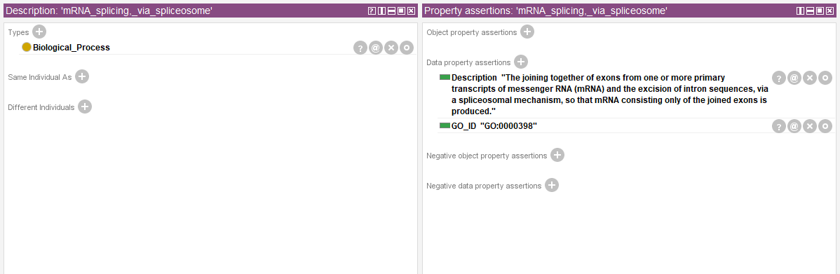
Example 1 on indinviduals

Slide 57
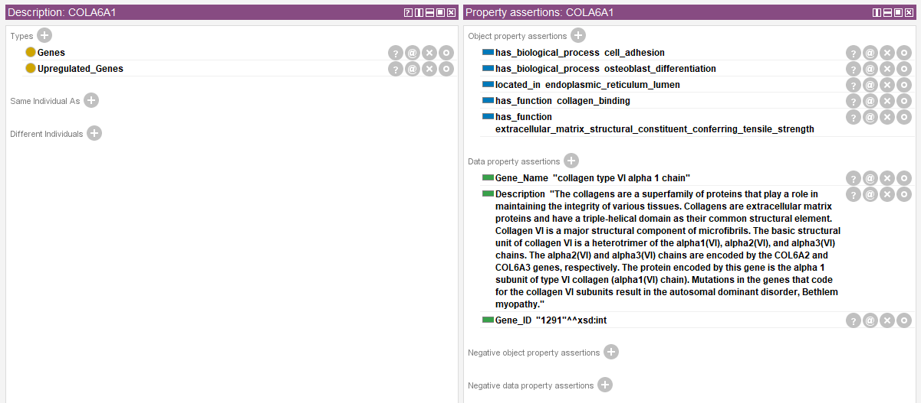
Example 2 on indinviduals

Slide 58

Example 3 on indinviduals

Slide 59

Example 4 on indinviduals

Slide 60

Queries

Slide 61

retrieve upregulated genes

Slide 62

retrieve downregulated genes

Slide 63

retrieve gene description

Slide 64

retrieve Molecular function Description for all genes

Slide 65

retrieve all data about genes

Slide 66

retrieve function of upregulated genes

Slide 67

retrieve function of Downregulated genes

Slide 68

retrieve cellular component for upregulated genes

Slide 69

retrieve cellular component for Downregulated genes

Slide 70

retrieve GO_ID of function for Downregulated genes

Slide 71

retrieve function and their description for upregulated genes

Slide 72

Rightfield

Slide 73

Rightfield

Slide 74

Rightfield 2

Slide 75

All SubClasses of ontology

Slide 76

All Direct SubClasses of Ontology

Slide 77

All SubClasses of Disease

Slide 78

All Direct SubClasses of Disease

Slide 79

All SubClasses of Genes

Slide 80

All Direct SubClasses of Genes

Slide 81

All instances of ontology

Slide 82

All instances of Biological_Process

Slide 83

All Direct instances of Biological_Process

Slide 84

All Direct instances of Biological_Process property

Slide 85

All instances of Cellular_Componant

Slide 86
All Direct instances of Cellular_Componant

Slide 87
All Direct instances of Cellular_Componant property

Slide 88

All instances of Genes

Slide 89

All Direct instances of Genes

Slide 90

All instances of Molecular_Function

Slide 91

All Direct instances of Molecular_Function

Slide 92


